Slide 1

Digital India Website
Roll No. | PRN | Name of Student | Contact No. | Email ID
35 | 1251130304 | Harshdeep Thadke |  | harshdeep.1251130304@vit.edu
36 | 1251130190 | Soham Thakkar |  | soham.12511301190@vit.edu
37 | 1251130133 | Shantanu Thombare |  | shantanu.1251130133@vit.edu
38 | 1251130017 | Shreyash Thorat |  | shreyash.1251130017@vit.edu
39 | 1251130114 | Supriya Thorat |  | Supriya.1251130114@vit.edu
Class: IT Division: F Batch:2
Project Guide:

Slide 2

INTRODUCTION
Digital India is one of the most ambitious programs initiated by the Government of India in 2015. Its main aim is to transform India into a digitally empowered society and a knowledge economy. The program focuses on providing government services online, improving internet access, promoting digital literacy, and encouraging technology-based solutions for everyday problems.
The importance of Digital India can be seen in its ability to:
Reduce corruption and make governance transparent
Make essential services available anytime and anywhere through online platforms
Encourage citizens to participate in digital economy activities like online banking, digital payments, and e-learning
Support entrepreneurship and innovation using technology
In this project, we have designed a Digital India website that explains the objectives, services, and benefits of Digital India in a structured and user-friendly manner. The website helps visitors understand how digital tools simplify life and promote efficiency in government and social services.

Slide 3
LIST OF TOPICS
* The website covers the following major topics related to Digital India:
Overview of Digital India – Meaning, objectives, and key vision areas
E-Governance Services – Online certificates, tax filing, and government schemes
Digital Infrastructure – High-speed internet, Wi-Fi hotspots, cloud platforms
Digital Literacy – Training citizens to use digital tools and bridging the digital divide
Online Education – Virtual classrooms, e-learning portals like SWAYAM and DIKSHA
Healthcare Services – Telemedicine and online consultations
Financial Inclusion – Digital banking, UPI, and mobile payments
Innovation & Startups – Technology-driven entrepreneurship support
Security & Privacy – Safe online transactions

Slide 4
TECHNOLOGIES USED
* To build this website, the following technologies were used:
HTML (HyperText Markup Language)
Provides the structure and content of the website
Used to create pages, headings, paragraphs, images, links, tables, and forms
CSS (Cascading Style Sheets)
Provides styling and layout for the website
Used to design modern layouts, fonts, colors, backgrounds, and responsive design
JavaScript
Adds interactivity to the website
Used for dynamic content such as buttons, forms, animations, and navigation menus
jQuery
A JavaScript library that simplifies DOM manipulation
Makes it easier to handle events, animations, and interactive features without writing complex code.
Deployment using GitHub and Vercel
The project was hosted online to make it accessible globally
GitHub: Used for version control and storing code in a repository
Vercel: Used to deploy the website live, allowing anyone to visit it using a URL
Benefits: Easy updates, collaboration, and sharing with teachers or students

Slide 5
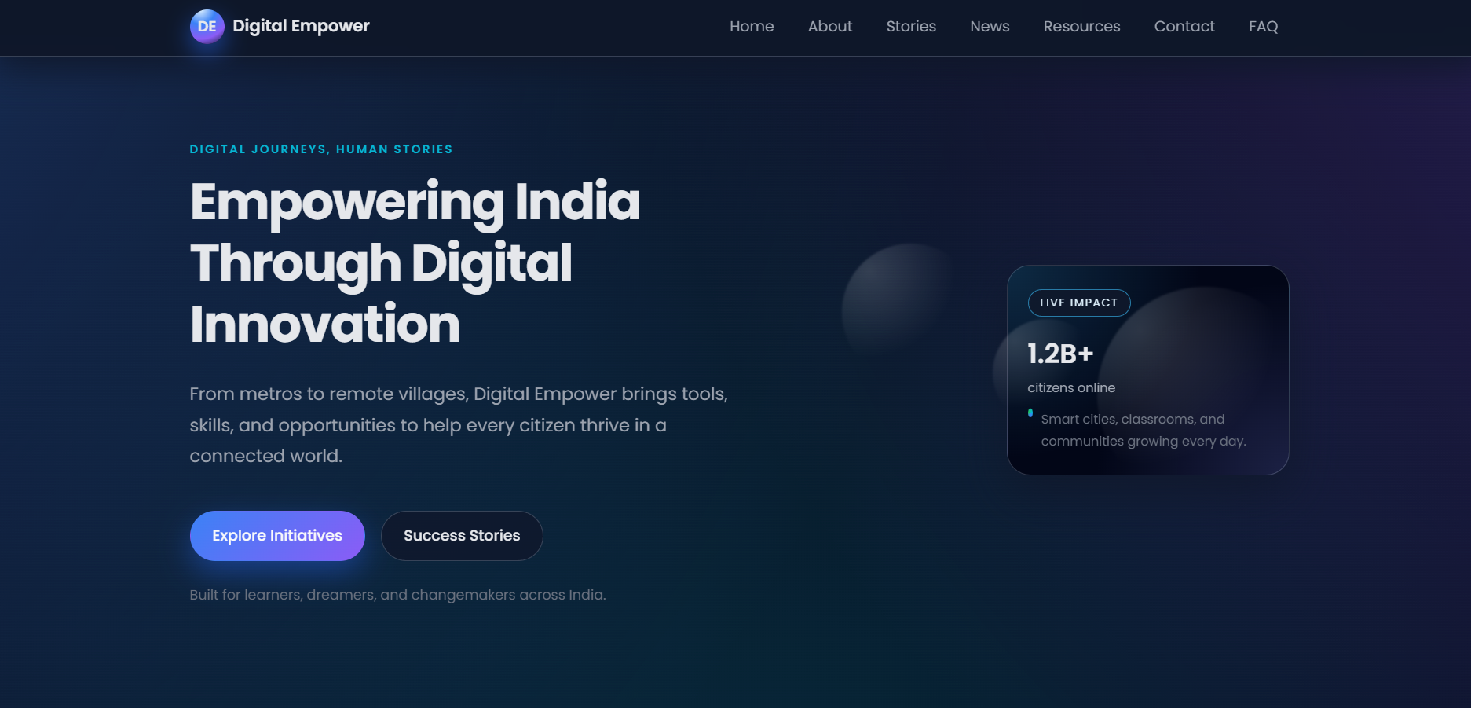
Final output of the project
Homepage: Attractive design with a brief introduction to Digital India, main
Navigation and featured section.

Slide 6
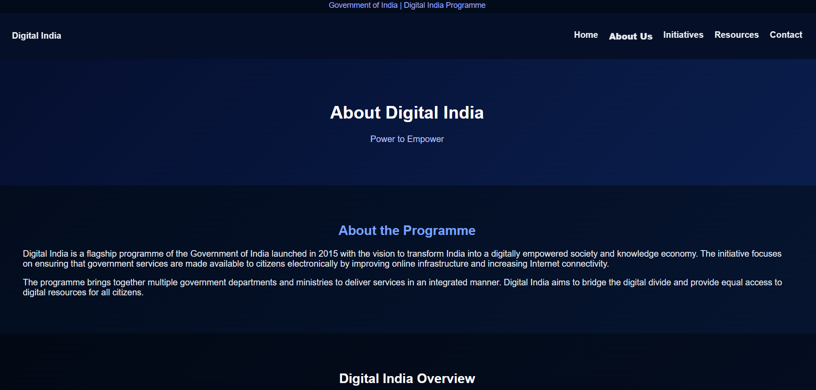
About Page: Explains the vision, objectives, and importance of Digital India.

Slide 7
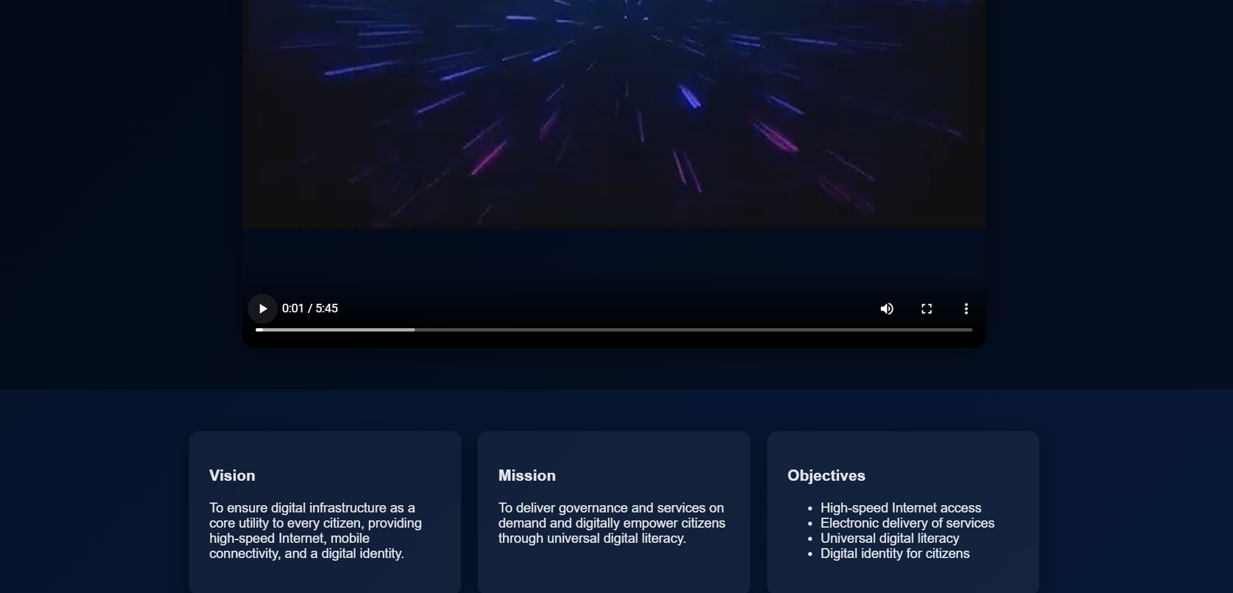
About page:

Slide 8
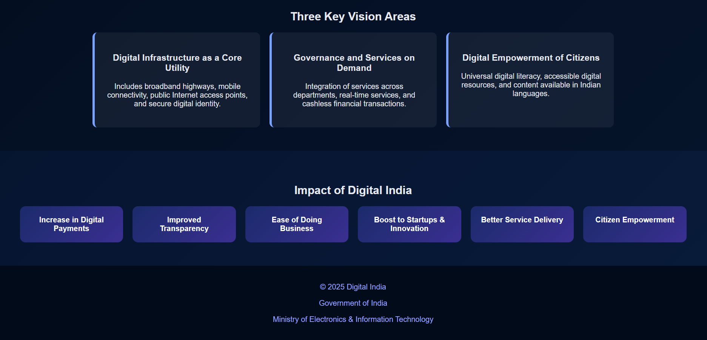
About page:

Slide 9
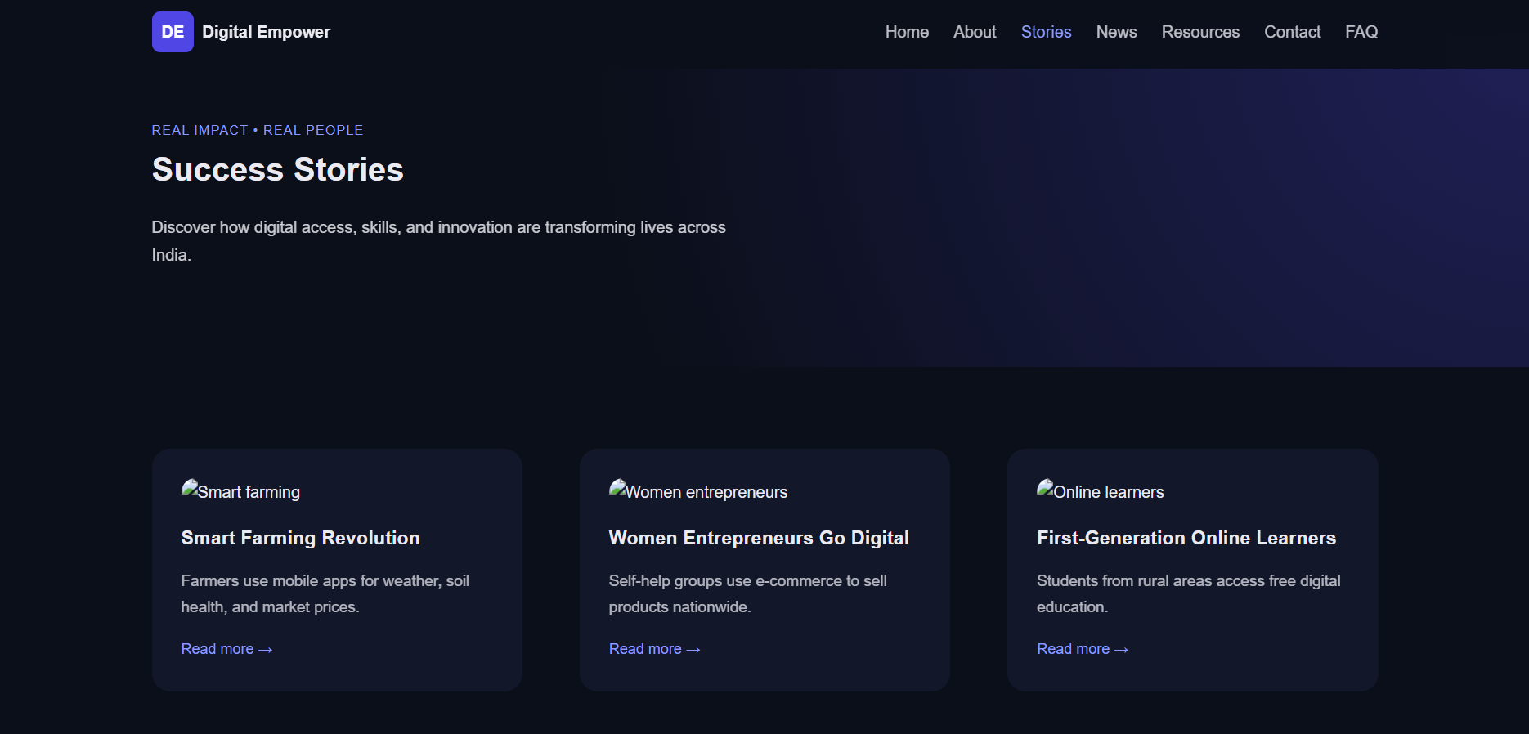
Success Page: Highlights success stories and achievements of Digital India initiatives.

Slide 10
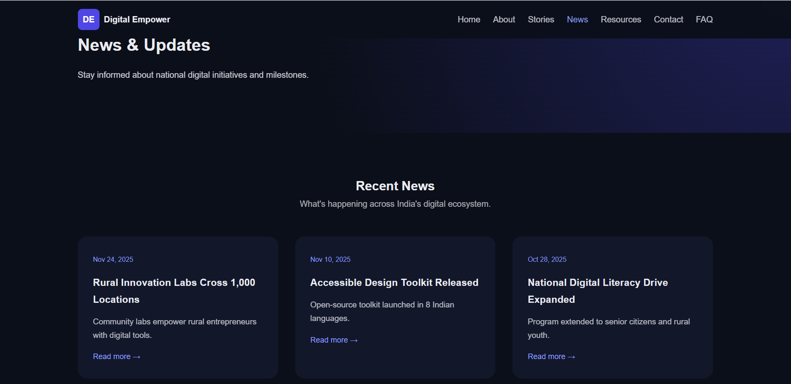
News Page: Displays latest updates and announcements related to Digital India initiatives.

Slide 11
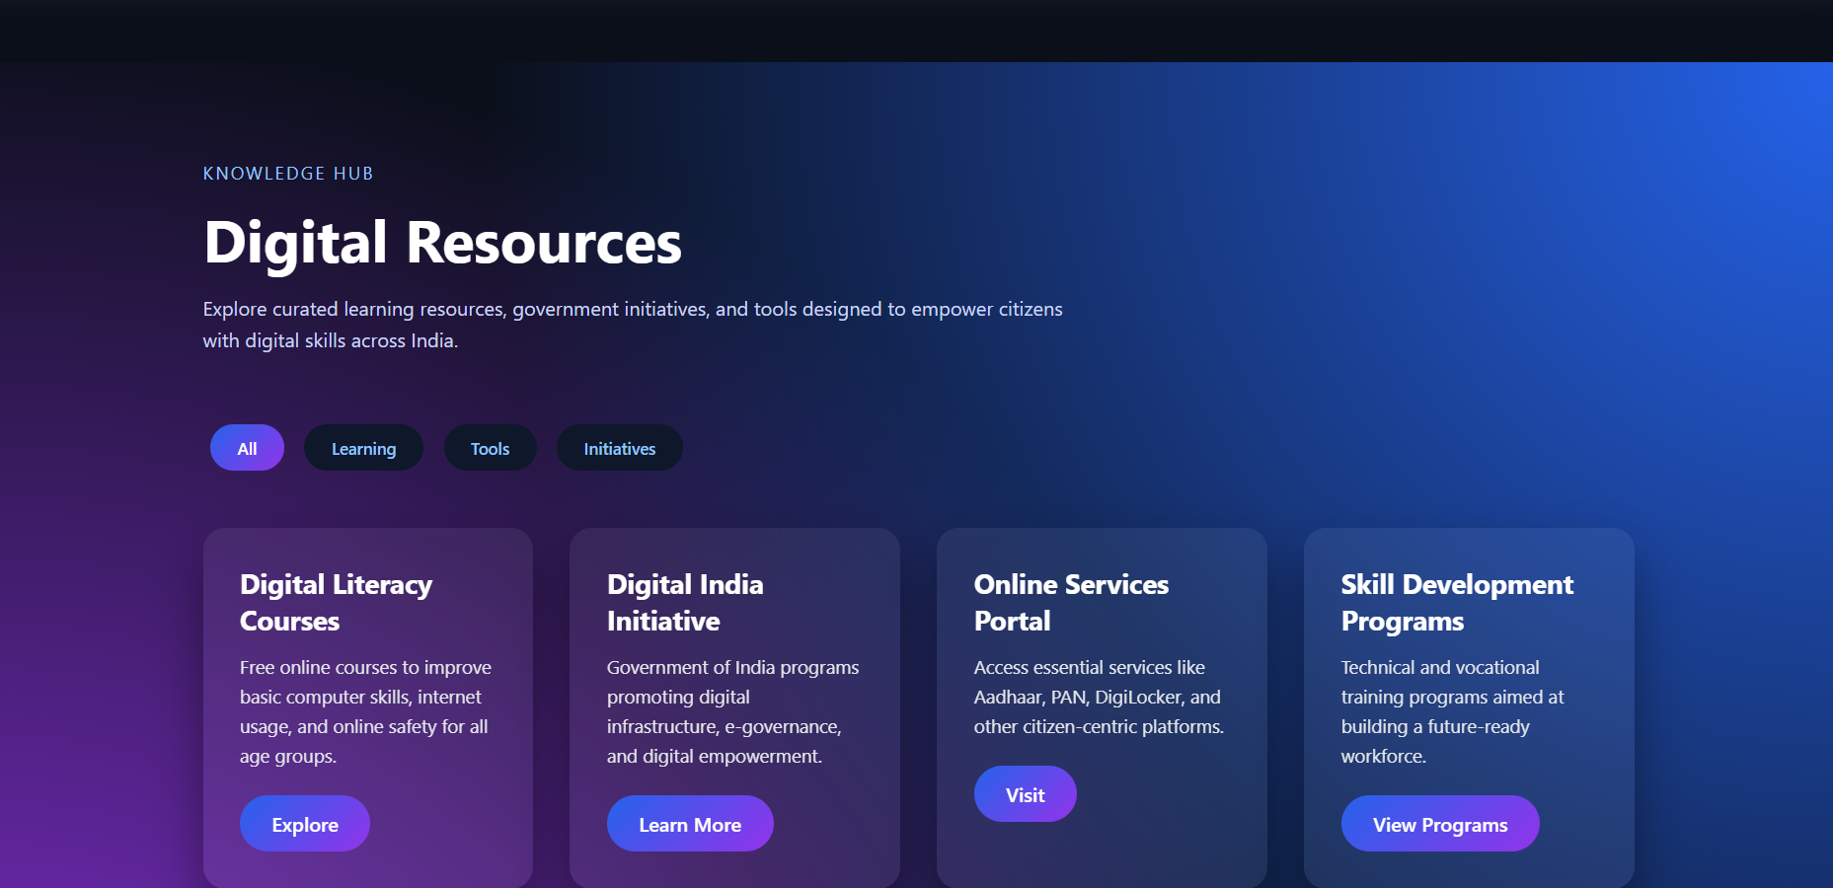
Resources Page: Provides useful links, documents, and digital learning materials for users.

Slide 12
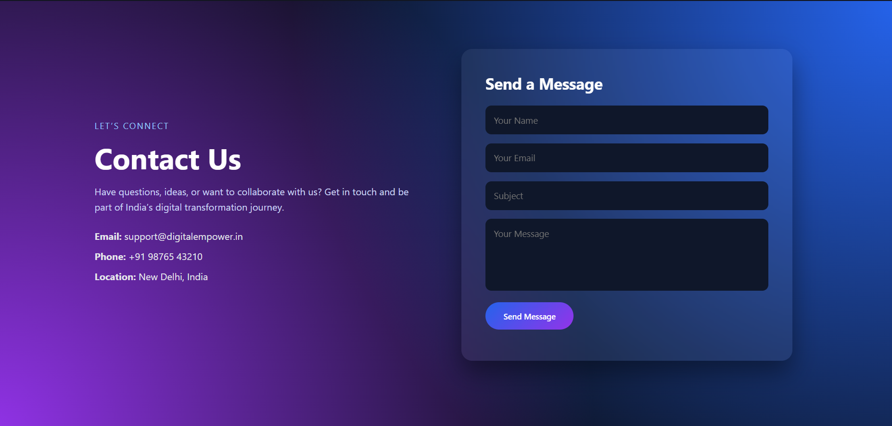
Contact Page: Allows users to submit queries or feedback through a contact form.

Slide 13
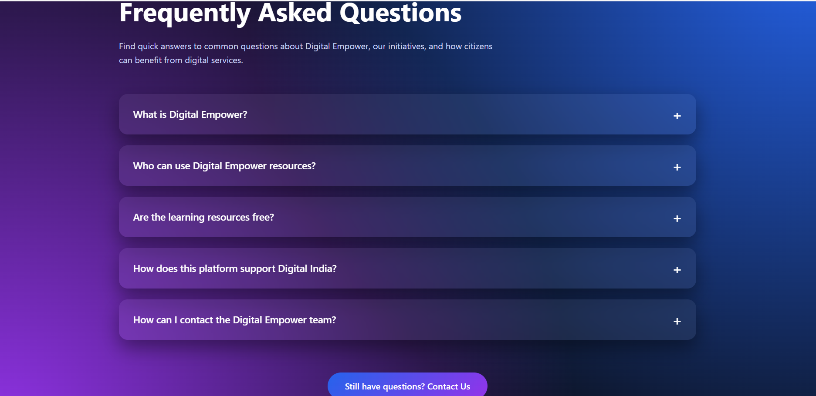
FAQ Page: Lists frequently asked questions to help users understand Digital India services.

Slide 14
Future scope
FUTURE SCOPE:
The Digital India website has a lot of potential for further development:
Backend Integration: Adding a server and database to manage data dynamically using Node.js, PHP, or Python
User Authentication: Allowing users to log in and access personalized services
AI Chatbots: To guide users through government services or answer FAQs automatically
Mobile App Version: Creating a mobile app for wider reach
Regional Language Support: Expanding the website to include multiple Indian languages
Additional Digital Services: Continuously updating the website with new government schemes, services, and educational resources
These enhancements can make the platform more interactive, inclusive, and technologically advanced, increasing its impact on society.

Slide 15
Conclusion
In conclusion, the Digital India website project demonstrates how technology can transform governance, education, healthcare, and everyday life.
By using HTML, CSS, JavaScript, and jQuery, we created a modern, responsive, and interactive website. With deployment on GitHub and Vercel, it is accessible to anyone globally, demonstrating real-world web development skills.
This project highlights:
How digital tools simplify access to government services
The importance of digital literacy and innovation
Opportunities for future expansion using backend technologies and AI
Overall, this project not only educates users about Digital India but also provides hands-on experience in web development, preparing students for future opportunities in technology and digital governance.
It represents a step towards a connected, informed, and digitally empowered India, aligning perfectly with the vision of the Digital India program.

Slide 16
Thank You

